Slide 1
Solving problems by searching
Chapter 3

Slide 2
Outline
Problem-solving agents
Problem types
Problem formulation
Example problems
Basic search algorithms

Slide 3
Example: Romania
On holiday in Romania; currently in Arad.
Flight leaves tomorrow from Bucharest
Formulate goal:
  be in Bucharest
  a goal is a set of world states—e.g. [Nairobi, Kisumu].
Formulate problem:
  states: various cities
  actions: drive between cities
Find solution:
  sequence of cities, e.g., Arad, Sibiu, Fagaras, Bucharest

Slide 4

Example: Romania

Slide 5
Goal Formulation
Goal is a set of states in the environment e.g [Nairobi, Kisumu].
Goal is satisfied if one of the states is reached.
    If a sequence of actions leads to the goal state, the goal has been satisfied and the problem is solved.
Goal can also be a function evaluation
    If (enemy health <=0)
    If (enemy in check mate)

Slide 6
Problem Formulation
What states to consider?
    Every square meter in Kenya?
    Towns in Kenya?
What actions to consider?
    Move left by a meter?
    Mpve from town X to town Y?
What information is stored in a node?
    Current town location
    Distance / time driven so far?

Slide 7
Problem types
Deterministic, fully observable → single-state problem
  Agent knows exactly which state it will be in; solution is a sequence
Non-observable → sensorless problem (conformant problem)
  Agent may have no idea where it is; solution is a sequence
Nondeterministic and/or partially observable → contingency problem
  percepts provide new information about current state
  often interleave} search, execution
Unknown state space → exploration problem

Slide 8
Problem Formulation
Initial state the agent starts in is known
Action possible for each state
    Transition/successor function
The set of goal states
    Goal state function
Action cost function
    Path cost = sum(cost(actions in path))

Slide 9
Example of problem definition
Initial state
    Nakuru
Action
    Towns connected by roads
Goal
    [Nairobi, Kisumu]
Action cost function
    Travel distance or time

Slide 10
Problem solution
Path from start state to a goal state
    Path = ordered sequence of actions
Solution cost = path cost
    Usually sum of cost of actions
    Most problems assume costs >0
Optimal solution has the lowest cost among possible solutions

Slide 11

Problem-solving agents

Slide 12
Example Problems
Toy problems (but sometimes useful)
  Illustrate or exercise various problem-solving methods
  Concise, exact description
  Can be used to compare performance
  Examples: 8-puzzle, 8-queens problem, Cryptarithmetic, Vacuum world, Missionaries and cannibals, simple route finding
Real-world problem
  More difficult
  No single, agreed-upon description
  Examples: Route finding, Touring and traveling salesperson problems, VLSI layout, Robot navigation, Assembly sequencing
Notes:
Toy problem おもちゃ問題 おもちゃもんだい
Illustrate 説明する せつめいする
Exercise 演習 えんしゅう
Concise 簡潔な かんけつな
Agreed 合意 ごうい
Description 記述 きじゅつ

Slide 13

Toy Problems: The vacuum world
The vacuum world
  The world has only two locations
  Each location may or may not contain dirt
  The agent may be in one location or the other
  8 possible world states
  Three possible actions: Left, Right, Suck
  Goal: clean up all the dirt
1
2
3
4
5
6
7
8
Notes:
Problem type 問題のタイプ もんだいのタイプ
Vacuum cleaner 掃除機 そうじき
Location 場所 ばしょ
Suck 吸込み すいこみ

Slide 14
Toy Problems:The vacuum world
  States: one of the 8 states given earlier
  Actions: move left, move right, suck
  Goal test: no dirt left in any square
  Path cost: each action costs one
R
S
S
L
R
R
S
S
L
L
R
L

Slide 15
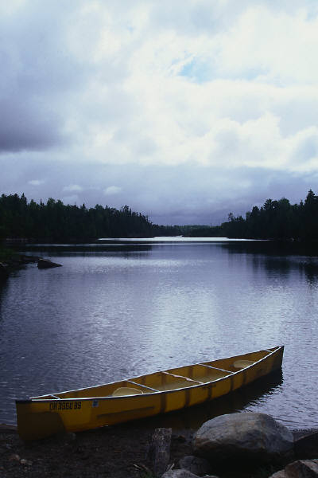
Missionaries and cannibals
Missionaries and cannibals
  Three missionaries and three cannibals want to cross a river
  There is a boat that can hold two people
  Cross the river, but make sure that the missionaries are not outnumbered by the cannibals on either bank
Needs a lot of abstraction
  Crocodiles in the river, the weather and so on
  Only the endpoints of the crossing are important
  Only two types of people
Notes:
Missionary 宣教師 せんきょうし
Cannibal 人食い人類 ひとくいじんるい
Outnumber 数に負ける かずにまける
Abstraction 抽象化 ちゅうしょうか
Endpoints 両岸 りょうがん

Slide 16
Missionaries and cannibals
Problem formulation
  States: ordered sequence of three numbers representing the number of missionaries, cannibals and boats on the bank of the river from which they started. The start state is (3, 3, 1)
  Actions: ?
  Goal test: ?
  Path cost: ?
Notes:
Missionary 宣教師 せんきょうし
Cannibal 人食い人類 ひとくいじんるい
Cross 渡る わたる
Outnumber 数に負ける かずにまける
Notion 概念 がいねん
Progress 進展 しんてん

Slide 17
Water jug
There are 2 empty water jugs, one holding 4 gallons, one holding 3 gallons. Fill the 4 gallon jug with exactly 2 gallons of water.
Problem formulation
  States: ?
  Actions: ?
  Goal test: ?
  Path cost?
Search space?
Notes:
Missionary 宣教師 せんきょうし
Cannibal 人食い人類 ひとくいじんるい
Cross 渡る わたる
Outnumber 数に負ける かずにまける
Notion 概念 がいねん
Progress 進展 しんてん

Slide 18
Real-world problems
Route finding
  Specified locations and transition along links between them
  Applications: routing in computer networks, automated travel advisory systems, airline travel planning systems
Touring and traveling salesperson problems
  “Visit every city on the map at least once and end in Bucharest”
  Needs information about the visited cities
  Goal: Find the shortest tour that visits all cities
  NP-hard, but a lot of effort has been spent on improving the capabilities of TSP algorithms
  Applications: planning movements of automatic circuit board drills
Notes:
Route finding ルート発見 ルートはっけん
Specified 規定された きていされた
Transition 遷移 せんい
Automated travel advice 自動旅行アドバイス じどうりょこうアドバイス
Airline travel planning 航空会社運行計画 こうくうがいしゃうんこうけいかく
Touring 旅行 りょこう
Traveling salesman 巡回セールスマン じゅんかいセールスマン
Visited 訪れた おとずれた
Shortest tour 最短の旅行 さいたんのりょこう
NP-hard NP-困難 NP-こんなん
Improve 改善する かいぜんする
Capability 能力 のうりょく
Circuit board drill 回路基板穿孔機 かいろきばんせんこうき

Slide 19
What is a Solution?
A sequence of actions that when performed will transform the initial state into a goal state (e.g., the sequence of actions that gets the missionaries safely across the river)
Vacuum solution?

Slide 20

Example: The 8-puzzle
states?
actions?
goal test?
path cost?

Slide 21
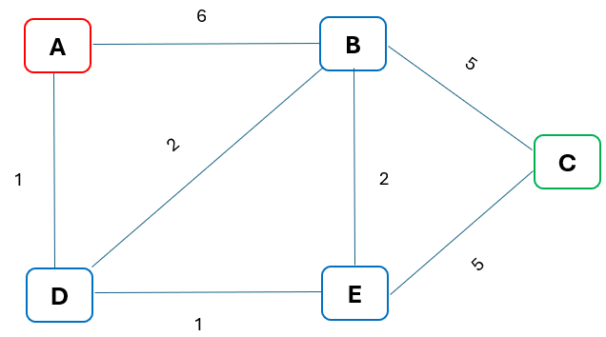
Example Graph Problem
Consider the following diagram
Initial state => state A
Actions => (A,B) is legal if an edge exits.
Goal state => state C
Action cost
  Edge label (A,B) = 6 {This cost could mean any type of cost}

Slide 22
Example Graph Problem
Consider the following diagram
Objective
    Is the path to the goal possible?
    What is the shortest path to goal?
Algorithm
    Which algorithm to use?
    Search algorithm?

Slide 23
Properties of the above graph problem
Fully observable
Static
Discrete
Deterministic
Single Agent
Sequential

Slide 24
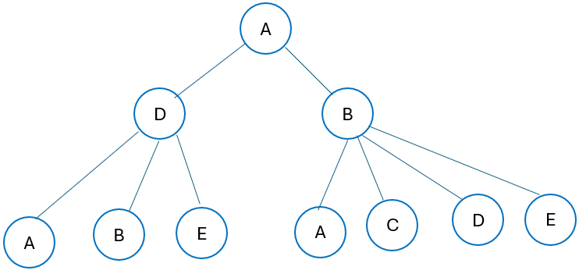
What is search?
Agent has several available actions.
Agent can explore various sequences of those actions.
Agent chooses the best sequence found.
This process is called search.
Search explores the search problem state space.
Searching generates a search tree.
The search tree will have nodes and edges.
The challenge is on which node to expand from A given nodes D and B.

Slide 25
What is search?
Information to store includes:
    State – the state in the graph
    Parent node
    Action
    Path cost – the cost of path so far denoted by g(n)
    Depth – the number of action nodes
    Other data e.g., optimization, legal actions etc.
Node vs state
    State is the configuration of the environment
    Node
      Bookkeeping data structure
      Exixts only within the search tree.
      Nodes are on paths in the search tree.

Slide 26
Problem solving performance
Completeness
    Is it guaranteed to find a solution if it exists?
Optimality
    Does it find the optimal solution?
Time complexity
    How long does it take to find the solution?
Space complexity
    How much memory is needed to run the search?

Slide 27
Time + Space complexity
Measured on size of input problem/graph.
Time measures the number of nudes generated.
Space measured by how much memory is needed to store the maximum number of nodes(worst case) at any given time.
Search traditional measures:
  Branching factor b (maximum successors at any given time)
  Depth d of the shallowest node,
  Tree size ~ b^{d}

Slide 28

Example: vacuum world
Single-state, start in #5. Solution?

Slide 29
Example: vacuum world
Single-state, start in #5.
Solution? [Right, Suck]
Sensorless, start in
{1,2,3,4,5,6,7,8} e.g.,
Right goes to {2,4,6,8}
Solution?

Slide 30
Example: vacuum world
Sensorless, start in
{1,2,3,4,5,6,7,8} e.g.,
Right goes to {2,4,6,8}
Solution?
[Right,Suck,Left,Suck]
Contingency
  Nondeterministic: Suck may
  dirty a clean carpet
  Partially observable: location, dirt at current location.
  Percept: [L, Clean], i.e., start in #5 or #7
  Solution?

Slide 31
Example: vacuum world
Sensorless, start in
{1,2,3,4,5,6,7,8} e.g.,
Right goes to {2,4,6,8}
Solution?
[Right,Suck,Left,Suck]
Contingency
  Nondeterministic: Suck may
  dirty a clean carpet
  Partially observable: location, dirt at current location.
  Percept: [L, Clean], i.e., start in #5 or #7
  Solution? [Right, if dirt then Suck]

Slide 32
Single-state problem formulation
A problem is defined by four items:
initial state e.g., "at Arad"
actions or successor function S(x) = set of action–state pairs
  e.g., S(Arad) = {<Arad → Zerind, Zerind>, … }
goal test, can be
  explicit, e.g., x = "at Bucharest"
  implicit, e.g., Checkmate(x)
path cost (additive)
  e.g., sum of distances, number of actions executed, etc.
  c(x,a,y) is the step cost, assumed to be ≥ 0
A solution is a sequence of actions leading from the initial state to a goal state

Slide 33
Selecting a state space
Real world is absurdly complex
  → state space must be abstracted for problem solving
(Abstract) state = set of real states
(Abstract) action = complex combination of real actions
  e.g., "Arad → Zerind" represents a complex set of possible routes, detours, rest stops, etc.
For guaranteed realizability, any real state "in Arad“ must get to some real state "in Zerind"
(Abstract) solution =
  set of real paths that are solutions in the real world
Each abstract action should be "easier" than the original problem

Slide 34

Vacuum world state space graph
states?
actions?
goal test?
path cost?

Slide 35
Vacuum world state space graph
states? integer dirt and robot location
actions? Left, Right, Suck
goal test? no dirt at all locations
path cost? 1 per action

Slide 36
Example: The 8-puzzle
states?
actions?
goal test?
path cost?

Slide 37
Example: The 8-puzzle
states? locations of tiles
actions? move blank left, right, up, down
goal test? = goal state (given)
path cost? 1 per move
[Note: optimal solution of n-Puzzle family is NP-hard]

Slide 38

Example: robotic assembly
states?: real-valued coordinates of robot joint angles parts of the object to be assembled
actions?: continuous motions of robot joints
goal test?: complete assembly
path cost?: time to execute

Slide 39

Tree search algorithms
Basic idea:
  offline, simulated exploration of state space by generating successors of already-explored states (a.k.a.~expanding states)

Slide 40

Tree search example

Slide 41

Tree search example

Slide 42

Tree search example

Slide 43

Implementation: general tree search

Slide 44

Implementation: states vs. nodes
A state is a (representation of) a physical configuration
A node is a data structure constituting part of a search tree includes state, parent node, action, path cost g(x), depth
The Expand function creates new nodes, filling in the various fields and using the SuccessorFn of the problem to create the corresponding states.

Slide 45
Search strategies
A search strategy is defined by picking the order of node expansion
Strategies are evaluated along the following dimensions:
  completeness: does it always find a solution if one exists?
  time complexity: number of nodes generated
  space complexity: maximum number of nodes in memory
  optimality: does it always find a least-cost solution?
Time and space complexity are measured in terms of
  b: maximum branching factor of the search tree
  d: depth of the least-cost solution
  m: maximum depth of the state space (may be ∞)

Slide 46
Uninformed search strategies
Uninformed (Blind) search strategies use only the information available in the problem definition
No information about states beyond the problem definition.
Limited to successor generation, goal test.
Examples:
  Breadth-first search
  Uniform-cost search
  Depth-first search
  Depth-limited search
  Iterative deepening search

Slide 47

Breadth-first search
Expand shallowest unexpanded node
Implementation:
  fringe is a FIFO queue, i.e., new successors go at end

Slide 48

Breadth-first search
Expand shallowest unexpanded node
Implementation:
  fringe is a FIFO queue, i.e., new successors go at end

Slide 49

Breadth-first search
Expand shallowest unexpanded node
Implementation:
  fringe is a FIFO queue, i.e., new successors go at end

Slide 50

Breadth-first search
Expand shallowest unexpanded node
Implementation:
  fringe is a FIFO queue, i.e., new successors go at end

Slide 51
Breadth-first search
Calculate the cost of getting to node c in the tree using BFS.

Slide 52
BFS performance
BFS is complete
  BFS explore entire tree, so it will find a goal node
  BFS will find the shallowest goal node, since it explores all nodes at a given depth before the next depth.
BFS is not optimal
  Ingeneral BFS does not produce optimal solutions since the shallowest node is not necessarily optimal.
  BFS is optimal if path cost is non-decreasing function on depth.
  BFS is optimal if action costs are all the same.

Slide 53
Performance of breadth-first search
Complete? Yes (if b is finite)
Time Complexity =O(b^{d})
  Each state has b children
  Consider goal at depth d
  b*b*b…..=O(b^{d})
Space Complexity =O(b^{d})
  Must store entire search tree in memory
  Space = nodes generated
Optimal? Yes (if cost = 1 per step)
Space is the bigger problem (more than time)

Slide 54
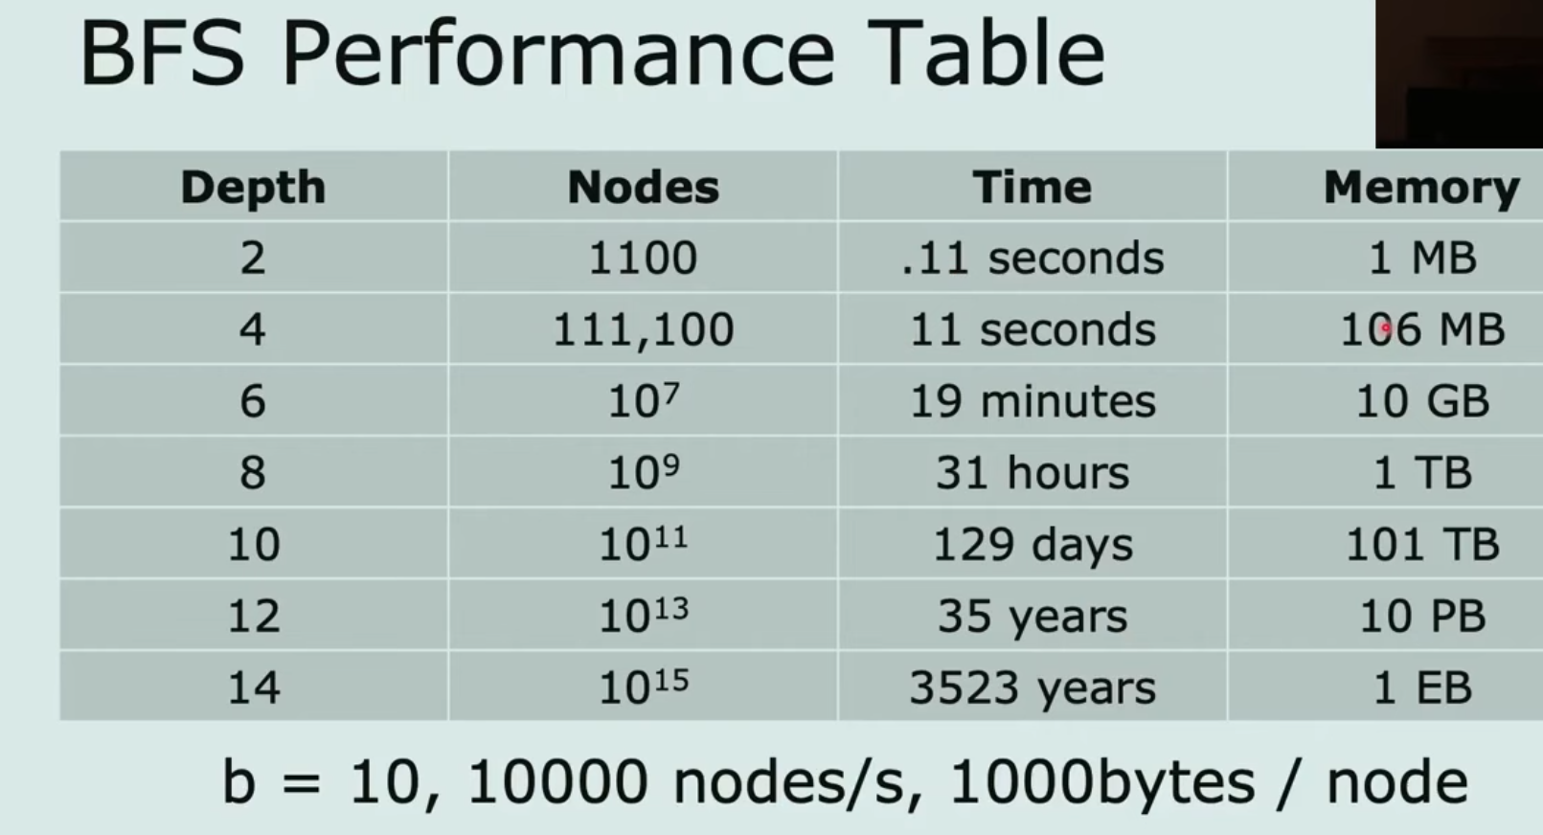
Performance of breadth-first search
Space is the bigger problem (more than time)

Slide 55
Uniform-cost search
Expand least-cost unexpanded node
Implementation:
  fringe = queue ordered by path cost
Equivalent to breadth-first if step costs all equal
Complete? Yes, if step cost ≥ ε
Time? # of nodes with g ≤ cost of optimal solution, O(b^{ceiling(C*/ ε)}) where C* is the cost of the optimal solution
Space? # of nodes with g ≤ cost of optimal solution, O(b^{ceiling(C*/ ε)})
Optimal? Yes – nodes expanded in increasing order of g(n)

Slide 56

Depth-first search
Expand deepest unexpanded node
Implementation:
  fringe = LIFO queue, i.e., put successors at front

Slide 57

Depth-first search
Expand deepest unexpanded node
Implementation:
  fringe = LIFO queue, i.e., put successors at front

Slide 58

Depth-first search
Expand deepest unexpanded node
Implementation:
  fringe = LIFO queue, i.e., put successors at front

Slide 59

Depth-first search
Expand deepest unexpanded node
Implementation:
  fringe = LIFO queue, i.e., put successors at front

Slide 60

Depth-first search
Expand deepest unexpanded node
Implementation:
  fringe = LIFO queue, i.e., put successors at front

Slide 61

Depth-first search
Expand deepest unexpanded node
Implementation:
  fringe = LIFO queue, i.e., put successors at front

Slide 62

Depth-first search
Expand deepest unexpanded node
Implementation:
  fringe = LIFO queue, i.e., put successors at front

Slide 63

Depth-first search
Expand deepest unexpanded node
Implementation:
  fringe = LIFO queue, i.e., put successors at front

Slide 64

Depth-first search
Expand deepest unexpanded node
Implementation:
  fringe = LIFO queue, i.e., put successors at front

Slide 65

Depth-first search
Expand deepest unexpanded node
Implementation:
  fringe = LIFO queue, i.e., put successors at front

Slide 66

Depth-first search
Expand deepest unexpanded node
Implementation:
  fringe = LIFO queue, i.e., put successors at front

Slide 67

Depth-first search
Expand deepest unexpanded node
Implementation:
  fringe = LIFO queue, i.e., put successors at front

Slide 68
Properties of depth-first search
Complete? No: fails in infinite-depth spaces, spaces with loops
  Modify to avoid repeated states along path
    → complete in finite spaces
Time? O(b^{m}): terrible if m is much larger than d
  but if solutions are dense, may be much faster than breadth-first
Space? O(bm), i.e., linear space!
Optimal? No

Slide 69

Depth-limited search
= depth-first search with depth limit l,
i.e., nodes at depth l have no successors
Recursive implementation:

Slide 70

Iterative deepening search

Slide 71

Iterative deepening search l =0

Slide 72

Iterative deepening search l =1

Slide 73

Iterative deepening search l =2

Slide 74

Iterative deepening search l =3

Slide 75
Iterative deepening search
Number of nodes generated in a depth-limited search to depth d with branching factor b:
N_{DLS} = b⁰ + b¹ + b² + … + b^{d-2} + b^{d-1} + b^{d}
Number of nodes generated in an iterative deepening search to depth d with branching factor b:
N_{IDS} = (d+1)b⁰ + d b^¹ + (d-1)b^² + … + 3b^{d-2} +2b^{d-1} + 1b^{d}
For b = 10, d = 5,
  N_{DLS} = 1 + 10 + 100 + 1,000 + 10,000 + 100,000 = 111,111
  N_{IDS} = 6 + 50 + 400 + 3,000 + 20,000 + 100,000 = 123,456
Overhead = (123,456 - 111,111)/111,111 = 11%

Slide 76
Properties of iterative deepening search
Complete? Yes
Time? (d+1)b⁰ + d b¹ + (d-1)b² + … + b^{d} = O(b^{d})
Space? O(bd)
Optimal? Yes, if step cost = 1

Slide 77

Summary of algorithms

Slide 78

Repeated states
Failure to detect repeated states can turn a linear problem into an exponential one!

Slide 79

Graph search

Slide 80
Summary
Problem formulation usually requires abstracting away real-world details to define a state space that can feasibly be explored
Variety of uninformed search strategies
Iterative deepening search uses only linear space and not much more time than other uninformed algorithms

